Slide 1
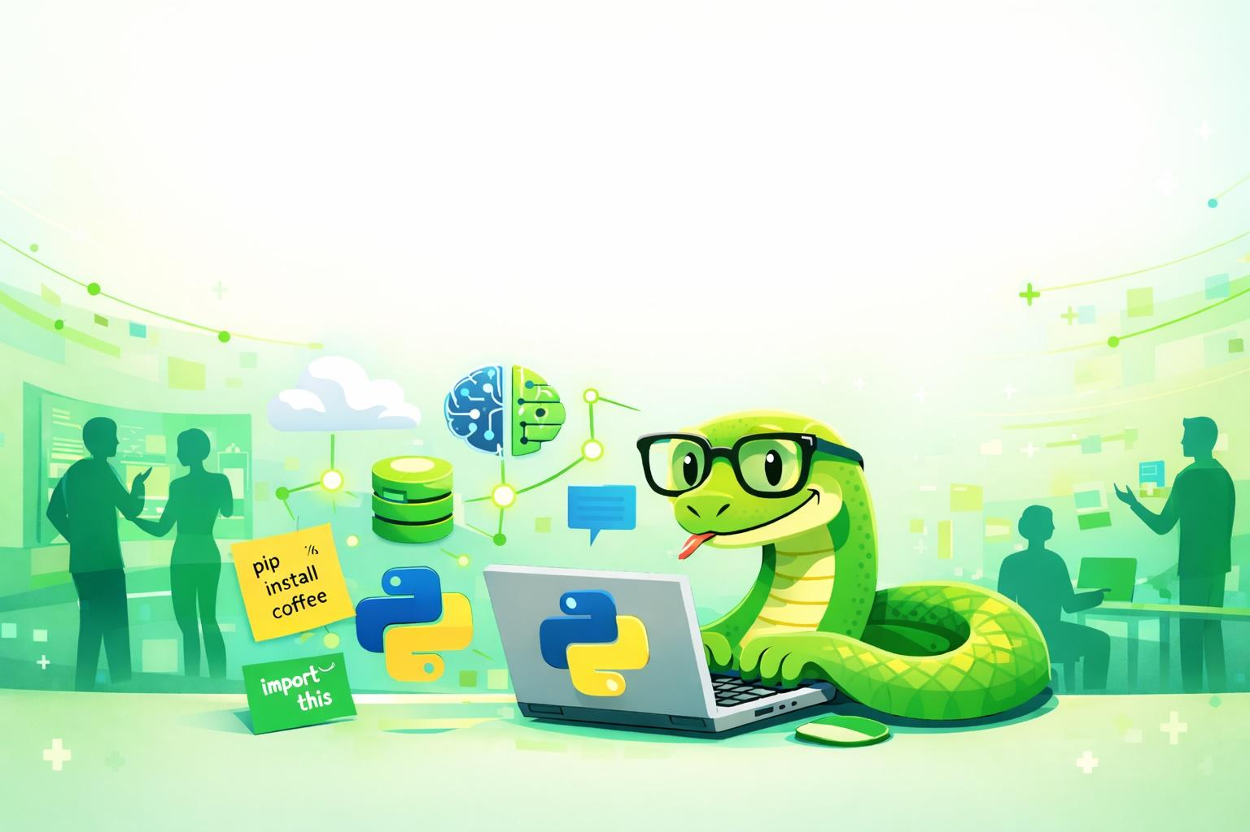
Werken met Python
Joey Visbeen
Jettro Coenradie
2026

Slide 2
Agenda
01
Setup Python project
Learn about the project manager `uv`, project structure and unit testing.
02
Program the game
Learn about classes, data classes, to run a maze game in Python.
03
Data Analysis
Using Python notebooks for data analysis
04
Create a GUI
Use Streamlit to create a GUI version of the game
05
Create a REST API
Using Fastapi to create a rest interface on the game.
06
Create an Agent
Use Strands to create an agent that plays the game

Slide 3
How it all works
Follow this link and clone the repository you find there:
https://go.jettro.dev/wspy
The repository contains Markdown files with the assignments. For each part of the workshop, we tell you the files to use.
There is a solution folder, use this if you are stuck, or if you are a bit lazy ;-)
There is a webapp folder, you can use this after finishing the Fastapi assignment.
!! Read everything; all information is important for completing the assignments.
If you reach the agent assignment, and you do not have a key for OpenAI, we provide one.

Slide 4
Setup project
01

Slide 5
Setup Python projects
Why Uv
It combines/replaces pip, pip-tools, pipx, poetry, pyenv, twine, virtualenv, and more.
Use UV to:
Manage Python versions
Manage dependencies
Run code
Run unit tests
Pytest
Learn how to write unit tests
ASSIGNMENT
Start working on 0_setting_up_the_project.md

Slide 6
Program the game
01

Slide 7
Program the adventure game
Add code for:
Compass and Move enums
Character and CharacterLocation data classes
The Board for the playing field
Moving the player from the start position
Add a result to a move when finding a character or the exit
Provide a directional tip through the compass
Create the game class to play the game on the board
Add a scoring mechanism to the game
Events
Adds events to the game that you can use in the next module.
ASSIGNMENT
Start working on 1_program_the_game.md
Continue with 2_add_events.md

Slide 8
Data Analysis
01

Slide 9
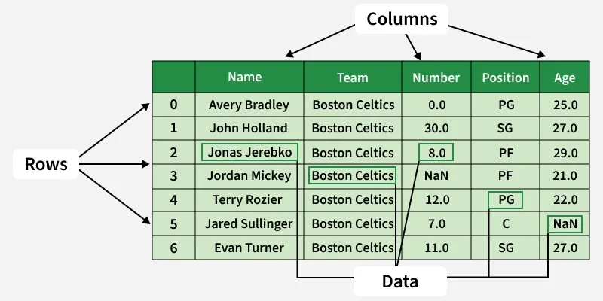
Data Analysis
Learn to work with Python notebooks:
Setup a notebook
Pandas (Dataframes)
NumPy (Complimentary)
Matplotlib (Charts)
ASSIGNMENT
Start working on
Dataframe manipulations
Data visualisation
Start working on 3_exploring_events.md
Really useful resource:
https://pandas.pydata.org/Pandas_Cheat_Sheet.pdf

Slide 10
Create a GUI
01

Slide 11
Create a GUI for the game
Learn to work with Streamlit:
Learn how to start the streamlit app
Understand concepts of reload on change for Streamlit
Write a GUI for the game, play around to make it look better
ASSIGNMENT
Start working on: 4_create_gui_streamlit.md

Slide 12
Create a REST + Agent
01

Slide 13
Create a REST API and an agent to play the game
Learn to work with FastAPI:
Keep track of multiple games
Implement the game class for FastAPI
Expose starting a new game through a REST endpoint
Implement the move method for the REST endpoint
Implement an agent with Strands
- Add MCP to the FastAPI application
Load the API Key
Add the code for the agent
Play with the prompt to make it do other things.
ASSIGNMENT
Start working on: 5_create_fastapi.md
Continue with: 6_use_agent_to_play_game.md

